Slide 1
Capseome Project: Team 2
Leticia, Milda, and Mai

Slide 2
Introduction
Dataset: PXD061542 — “SOX9-dependent fibrosis drives renal function in nephronophthisis”
Study focus: Role of SOX9 in kidney fibrosis (nephronophthisis)
Organism/Model: FBXW7 knock-out IMCD-3 cell lines
Technology: Orbitrap Exploris 480 mass spectrometry
Source: PRIDE repository (ProteomeXchange Consortium)

Slide 3
Capseome Project
1. 📁 Dataset Acquisition
2. 🧱 PSM Object Creation & Preprocessing
3. 🧬 Protein & Peptide Identification
4. 🔄 QFeature Aggregation (Optional)
5. 🧼 Normalization & Imputation (Optional)
6. 🧪 Protein Inference & Quantification (Optional)
7. 📊 Statistical Analysis (Optional)
8. 📈 Visualization & Export (Optional)
9. 📖 Comparison with Published Results
10. 📝 Final Report & Interpretation

Slide 4
1. Data Acquisition
Accessed via R package: rpx
No .mzID files provided by PRIDE
mzML were processed by SearchGUI to produce 10 mzID filed.
.mzID files were too large (~1 GB each)
Converted to .csv using Python (Anaconda) for efficient R processing

Slide 5
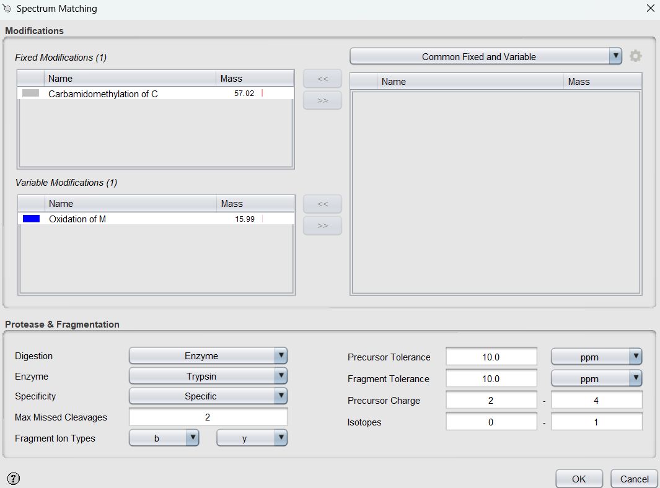
Search GUI Conidtions
MS-GF+ engine
Swiss Prot database
Human Genome FASTA with decoys
Number of peptide matches: 10
Max variable PTMs per peptide: 2

Slide 6
2. PSM Creation & Preprocessing
Read and combined 10 .csv files in R
Data pre-filtered in SearchGUI:
Non-decoy
Rank 1 only

Slide 7
3. Identification
Total PSMs: 1,505,627
Unique peptide sequences: 18,687
Unique protein accessions: 11,860
Confirms successful processing of deep, high-confidence proteomics data

